Slide 1
Sect. 7.6 Graphing Logarithmic Functions with Transformations
© Copyright all rights reserved to Homework depot: www.BCMath.ca

Slide 2
Graphs of Logarithmic Functions:
The graph of a logarithmic function is the “INVERSE” of an exponential function
The graph of $y={10}^{x} and y=logx$ are reflections of each other over the line $y=x$
Exponential Function:
Inverse Reflection:
Logarithmic Equation:
y
4
3
2
1
x
-4
-3
-2
-1
0
1
2
3
4
-1
-2
-3
-4

Slide 3
Logarithmic Functions are Inverses of Exponential Functions
The graph of a logarithmic function is an inverse function of an exponential function with the same base
Exponential Function:
Inverse Reflection:
Logarithmic Equation:
y
4
3
2
1
x
-4
-3
-2
-1
0
1
2
3
4
Since we have a restriction at x > 0, we have a vertical asymptote at x=0
-1
-2
-3
-4

Slide 4
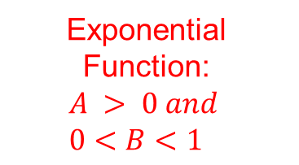
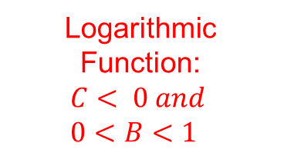
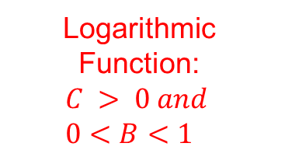
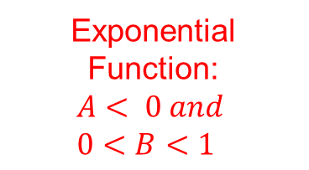
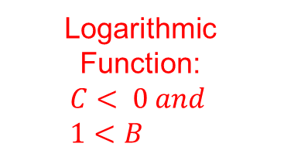
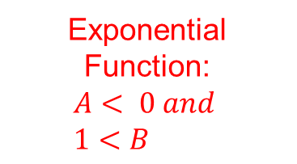
Inverse of Different Exponential Functions:
Exponential Function: $$A > 0 and \\ 0<B<1$$
Logarithmic Function: $$C > 0 and \\ 0<B<1$$
Exponential Function: $$A< 0 and \\ 1<B$$
Logarithmic Function: $$C< 0 and \\ 1<B$$
Exponential Function: $$A< 0 and \\ 0<B<1$$
Logarithmic Function: $$C< 0 and \\ 0<B<1$$
Decreasing Function
Vertical Reflection
y
y
y
4
4
4
3
3
3
2
2
2
1
1
1
x
x
x
-4
-3
-2
-1
0
1
2
3
4
-4
-3
-2
-1
0
1
2
3
4
-4
-3
-2
-1
0
1
2
3
4
-1
-1
-1
-2
-2
-2
-3
-3
-3
-4
-4
-4

Slide 5




How to Read a Logarithmic Function:
When reading or graphing a logarithmic function, start by looking at the value of the base “B”
If the “base” is bigger than 1, then it will open from bottom and go up!
If the “base” is between 0 and 1, then it will open from the top and go down
$$C< 0$$
y
y
4
$$C > 0$$
4
3
3
2
2
1
1
x
x
-4
-3
-2
-1
0
1
2
3
4
-4
-3
-2
-1
0
1
2
3
4
-1
-1
-2
-2
-3
-3
-4
-4
$$C< 0$$
$$C > 0$$

Slide 6
Make it Simple: Keep “A” positive
If the leading coefficient “A” is negative, remove the negative sign by “flipping” the base!
One log property is that you can move the exponent of the base to the front as a coefficient
In contrast, if the leading coefficient is negative, move that negative sign to become an exponent for the base
A value to the power of -1 is equal it’s reciprocal
By flipping the base, we removed the negative sign in the coefficient and wont need to perform a vertical reflection

Slide 7
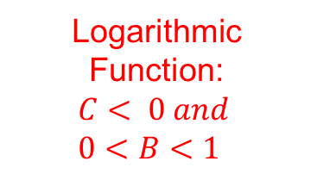
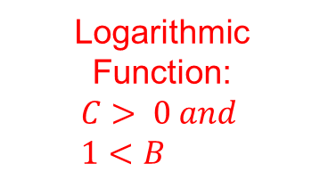

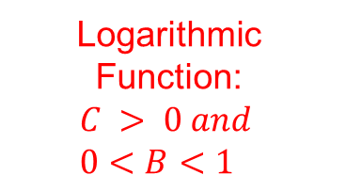
General Graphs of Logs with Different Bases:
Logarithmic Function: $$C> 0 and \\ 1<B$$
Logarithmic Function: $$C > 0 and \\ 0<B<1$$
Logarithmic Function: $$C< 0 and \\ 1<B$$
Logarithmic Function: $$C< 0 and \\ 0<B<1$$
Since graph is ‘decreasing’ is falls down to the right
Graph opens up to the right
“increasing” but Opens to the left
“decreasing” but Opens to the left
y
y
y
y
4
4
4
4
3
3
3
3
2
2
2
2
1
1
1
1
x
x
x
x
-4
-3
-2
-1
0
1
2
3
4
-4
-3
-2
-1
0
1
2
3
4
-4
-3
-2
-1
0
1
2
3
4
-4
-3
-2
-1
0
1
2
3
4
-1
-1
-1
-1
-2
-2
-2
-2
-3
-3
-3
-3
-4
-4
-4
-4

Slide 8
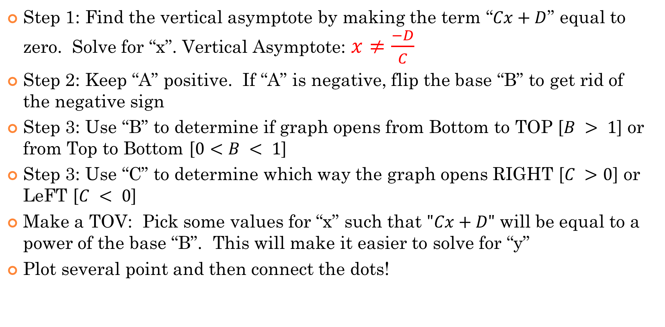
Steps for graphing a Logarithmic Function:
Step 1: Find the vertical asymptote by making the term “$Cx+D$” equal to zero. Solve for “x”. Vertical Asymptote: $x≠\frac{−D}{C}$
Step 2: Keep “A” positive. If “A” is negative, flip the base “B” to get rid of the negative sign
Step 3: Use “B” to determine if graph opens from Bottom to TOP [$B > 1$] or from Top to Bottom [$0<B < 1$]
Step 3: Use “C” to determine which way the graph opens RIGHT [$C >0$] or LeFT [$C < 0$]
Make a TOV: Pick some values for “x” such that $"Cx+D"$ will be equal to a power of the base “B”. This will make it easier to solve for “y”
Plot several point and then connect the dots!

Slide 9











Ex: Given each function, state the values of “A”, “B”, “C”, “D” and “E”.
ii) Indicate which way the graph opens, UP, DOWN, LEFT, or RIGHT. |
iii) Find the equation of the Vertical Asymptote, “X” intercept, and “Y” intercept.
$$Y−int: (x=0)$$
A:
B:
C: D: E:
$$=2$$
$With 0<B<1$ the graph opens down
$$=0.8$$
$With 0<C$ the graph opens to the right
$$=5$$
$$=3$$
$$Vertical Asymptote$$
$$No Y−intercept$$
$$=1$$
$$X−int: (y=0)$$

Slide 10











First get rid of the negative sign in the coefficient by flipping the base!
$$Y−int: (x=0)$$
$$Y−intercept(0,19.913)$$
A:
B:
C: D: E:
$$=3$$
$With 1<B$ the graph opens up
$$=4/3$$
$$X−int: (y=0)$$
$With C<0$ the graph opens to the left
$$=−7$$
$$=12$$
$$Vertical Asymptote$$
$$=−6$$

Slide 11
Ex: Graph the following function:
i) Find the eqn of the VA
ii) Indicate the domain and range
V.A.:
y
2
X-int:
x
-4
-2
0
2
4
6
8
-2
-4
-6
Base is 10, so graph
will open UP!
-8
© Copyright all rights reserved to Homework depot: www.BCMath.ca

Slide 12
Graph the following functions:
i) State the equations of the Vertical asymptotes
ii) Find the coordinates of the “x” intercept
iii) Find the domain and Range:

Slide 13
Ex: Graph
V.A.:
X-int:
y
10
8
6
4
2
Now pick a nice number for “x” s.t. (3-2x) is a power of 2
x
-4
-3
-2
-1
0
1
2
3
4
-2
-4
-6
DOMAIN:
-8
-10
Range:

Slide 14
Graph the following function
V.A.:
X-int:
y
6
4
2
x
-2
0
2
4
6
8
Now pick a nice number for “x” s.t. (6-2x) is a power of 3
-2
-4
-6
-8
-10
DOMAIN:
-12
-14
Range:

Slide 15
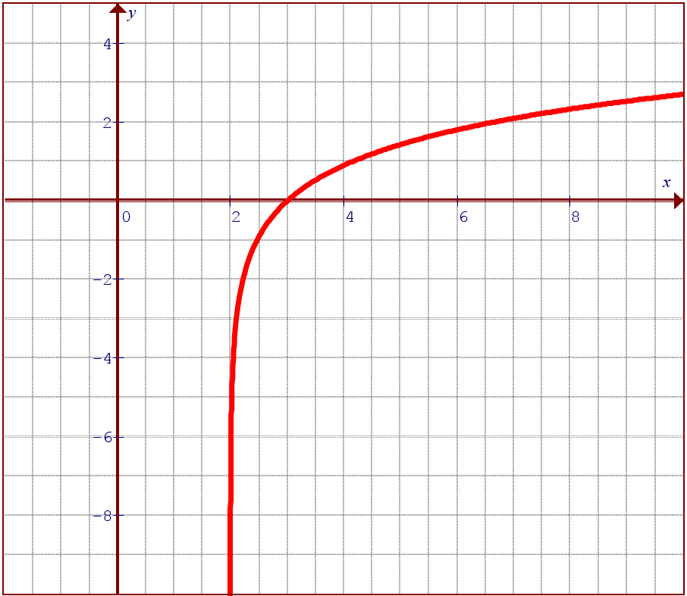
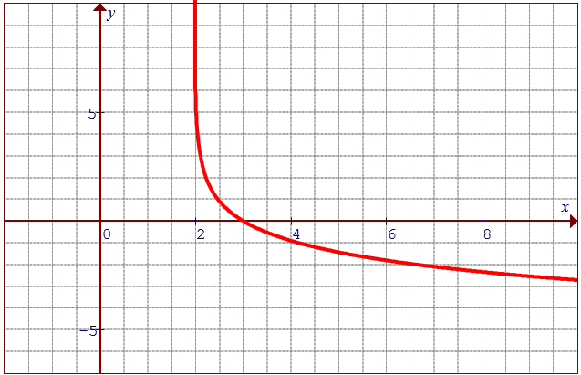
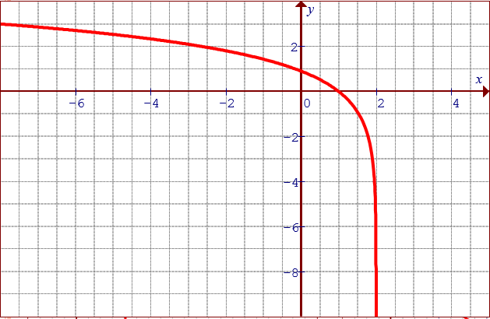
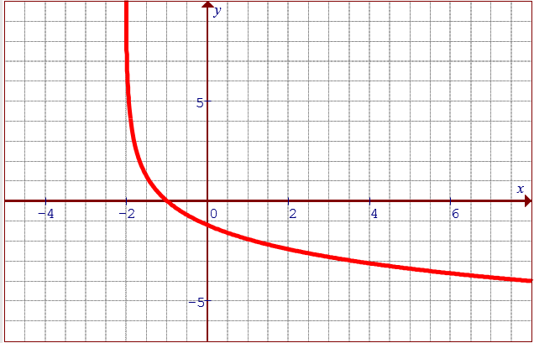
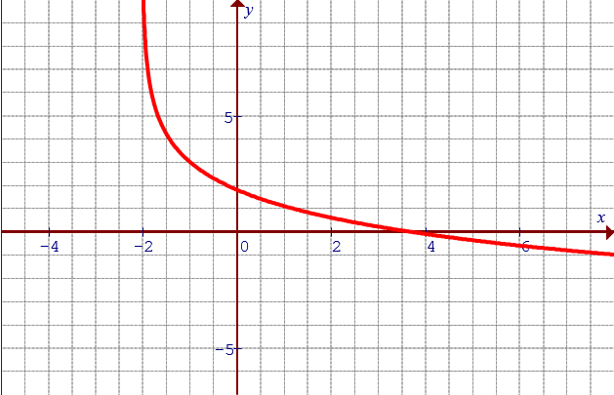
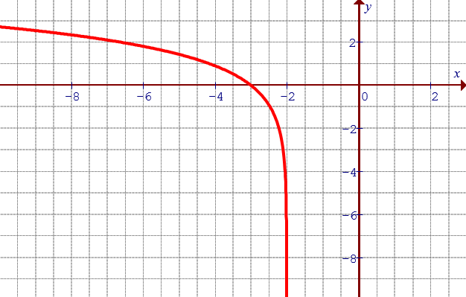
Match each Graph with the correct equation:

Slide 16
Ex: Indicate the transformations, vertical asymptote, domain, and X-intercept with each of the following equations
V.C. by a factor of 2/3
H.S. of 4 units right
X-intercept
V.A.:
Domain:
V.R. and V.E. by a factor of 4
H.C. by a factor of ½
H.S. 1.5 units right
V.S. 3 units up
V.A.:
X-intercept
Domain:
© Copyright all rights reserved to Homework depot: www.BCMath.ca

Slide 17
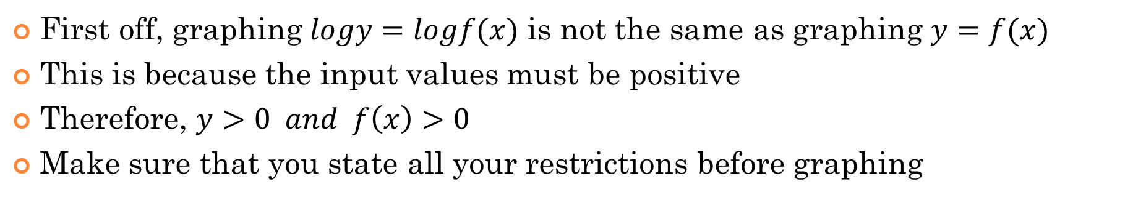
Graphing Logarithmic functions:
First off, graphing $logy=logf(x)$ is not the same as graphing $y=f(x)$
This is because the input values must be positive
Therefore, $y>0 and f\left(x\right)>0$
Make sure that you state all your restrictions before graphing
Note: The graphs of
and
are not the same!!
“x” can not be negative!!
“x” can be all real values…
“x” can not be negative!!
Q: Graph the function and indicate the domain and range?

Slide 18
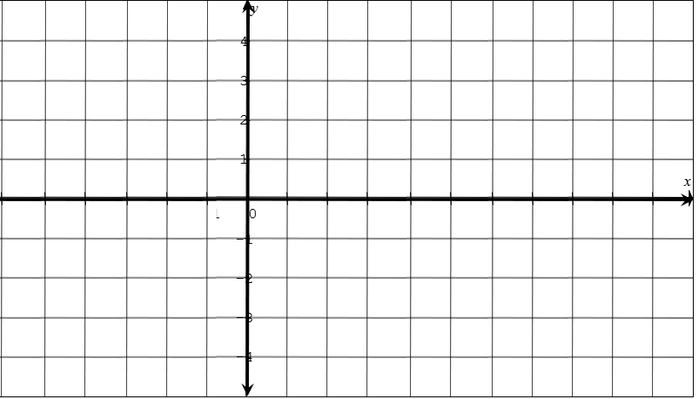
Q: Graph the function and indicate the domain and range?
y
10
8
6
4
2
x
-8
-6
-4
-2
0
2
4
6
8
-2
-4
-6
-8
-10

Slide 19
Ex: The following function is reflected over the y-axis. Which of the following will be the resulting equation?
A reflected over the y-axis is a H.R.
Note: A H.R. will occur when you take
the reciprocal of the base in an
exponential function
© Copyright all rights reserved to Homework depot: www.BCMath.ca

Slide 20
y
x

Slide 21
y
6
4
2
x
-7
-6
-5
-4
-3
-2
-1
0
1
2
3
4
5
6
7
-2

